Slide 1
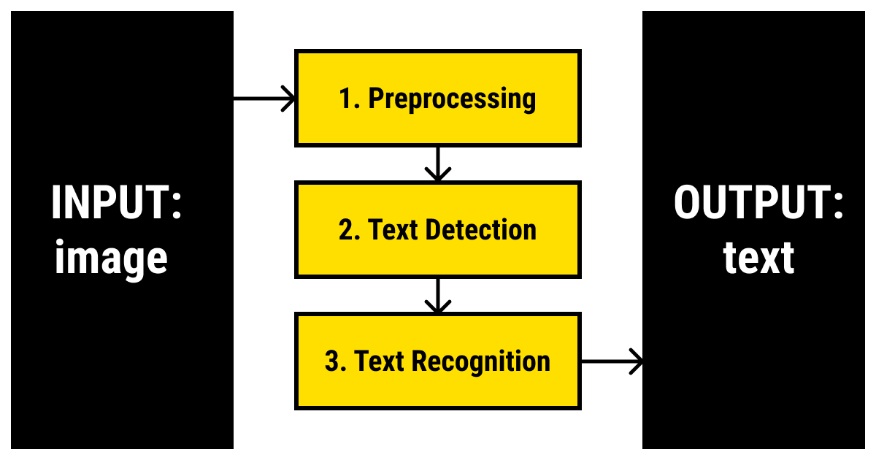
CUSTOM OBJECT CHARACTER RECOGNITION
NAME: S. SUJANA KUMARI AFFILIATION: DIGICROME ACADEMY

Slide 2
PROJECT OVERVIEW
Objective:
To build a Custom OCR by combining YOLO and Tesseract, to read the specific contents of a Lab Report and convert it into an editable file. Use YOLO_V3 to train on the personal dataset. Then the coordinates of the detected objects are passed for cropping the detected objects and storing them in another list. This list is passed through the Tesseract to get the desired output.

Slide 3
Phase 1: Environment Setup
INSTALL REQUIRED LIBRARIES:
import streamlit as st
import torch
from ultralytics import YOLO
import cv2
import numpy as np
from PIL import Image
import pytesseract
import cv2
import os
DEPENDENCIES: ● Install Tesseract OCR Engine in the system ● Install Pytesseract library pip install pytessercat ● Install OpenCV pip opencv

Slide 4
PHASE 2: RESIZING THE IMAGES AND LABELLING
The first step of the process is taking the bounding box coordinates from YOLOv3 and simply taking the region within the bounds of the box. As this image is super small, we use cv2.resize() to blow the image up 3x its original size.
Then I labelled the images by creating bounding boxes consisting of 4 classes i.e., TestName, Value, Units and NormalRange from which I got the labelled images in yolo format with respective file names in labels folder.

Slide 5
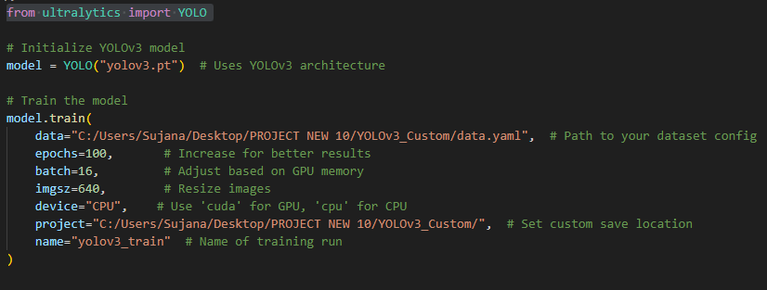
PHASE 3: TRAINING THE YOLOV3 MODEL
After creating the labels and getting the labels for each image, I trained the using Yolo3 architecture named Yolov3.pt
Below is the code for training the model trained using 100 epochs, 16 batches, 640 image size, and named yolov3_train.
After training the yolo model I got weights named as best.pt.

Slide 6
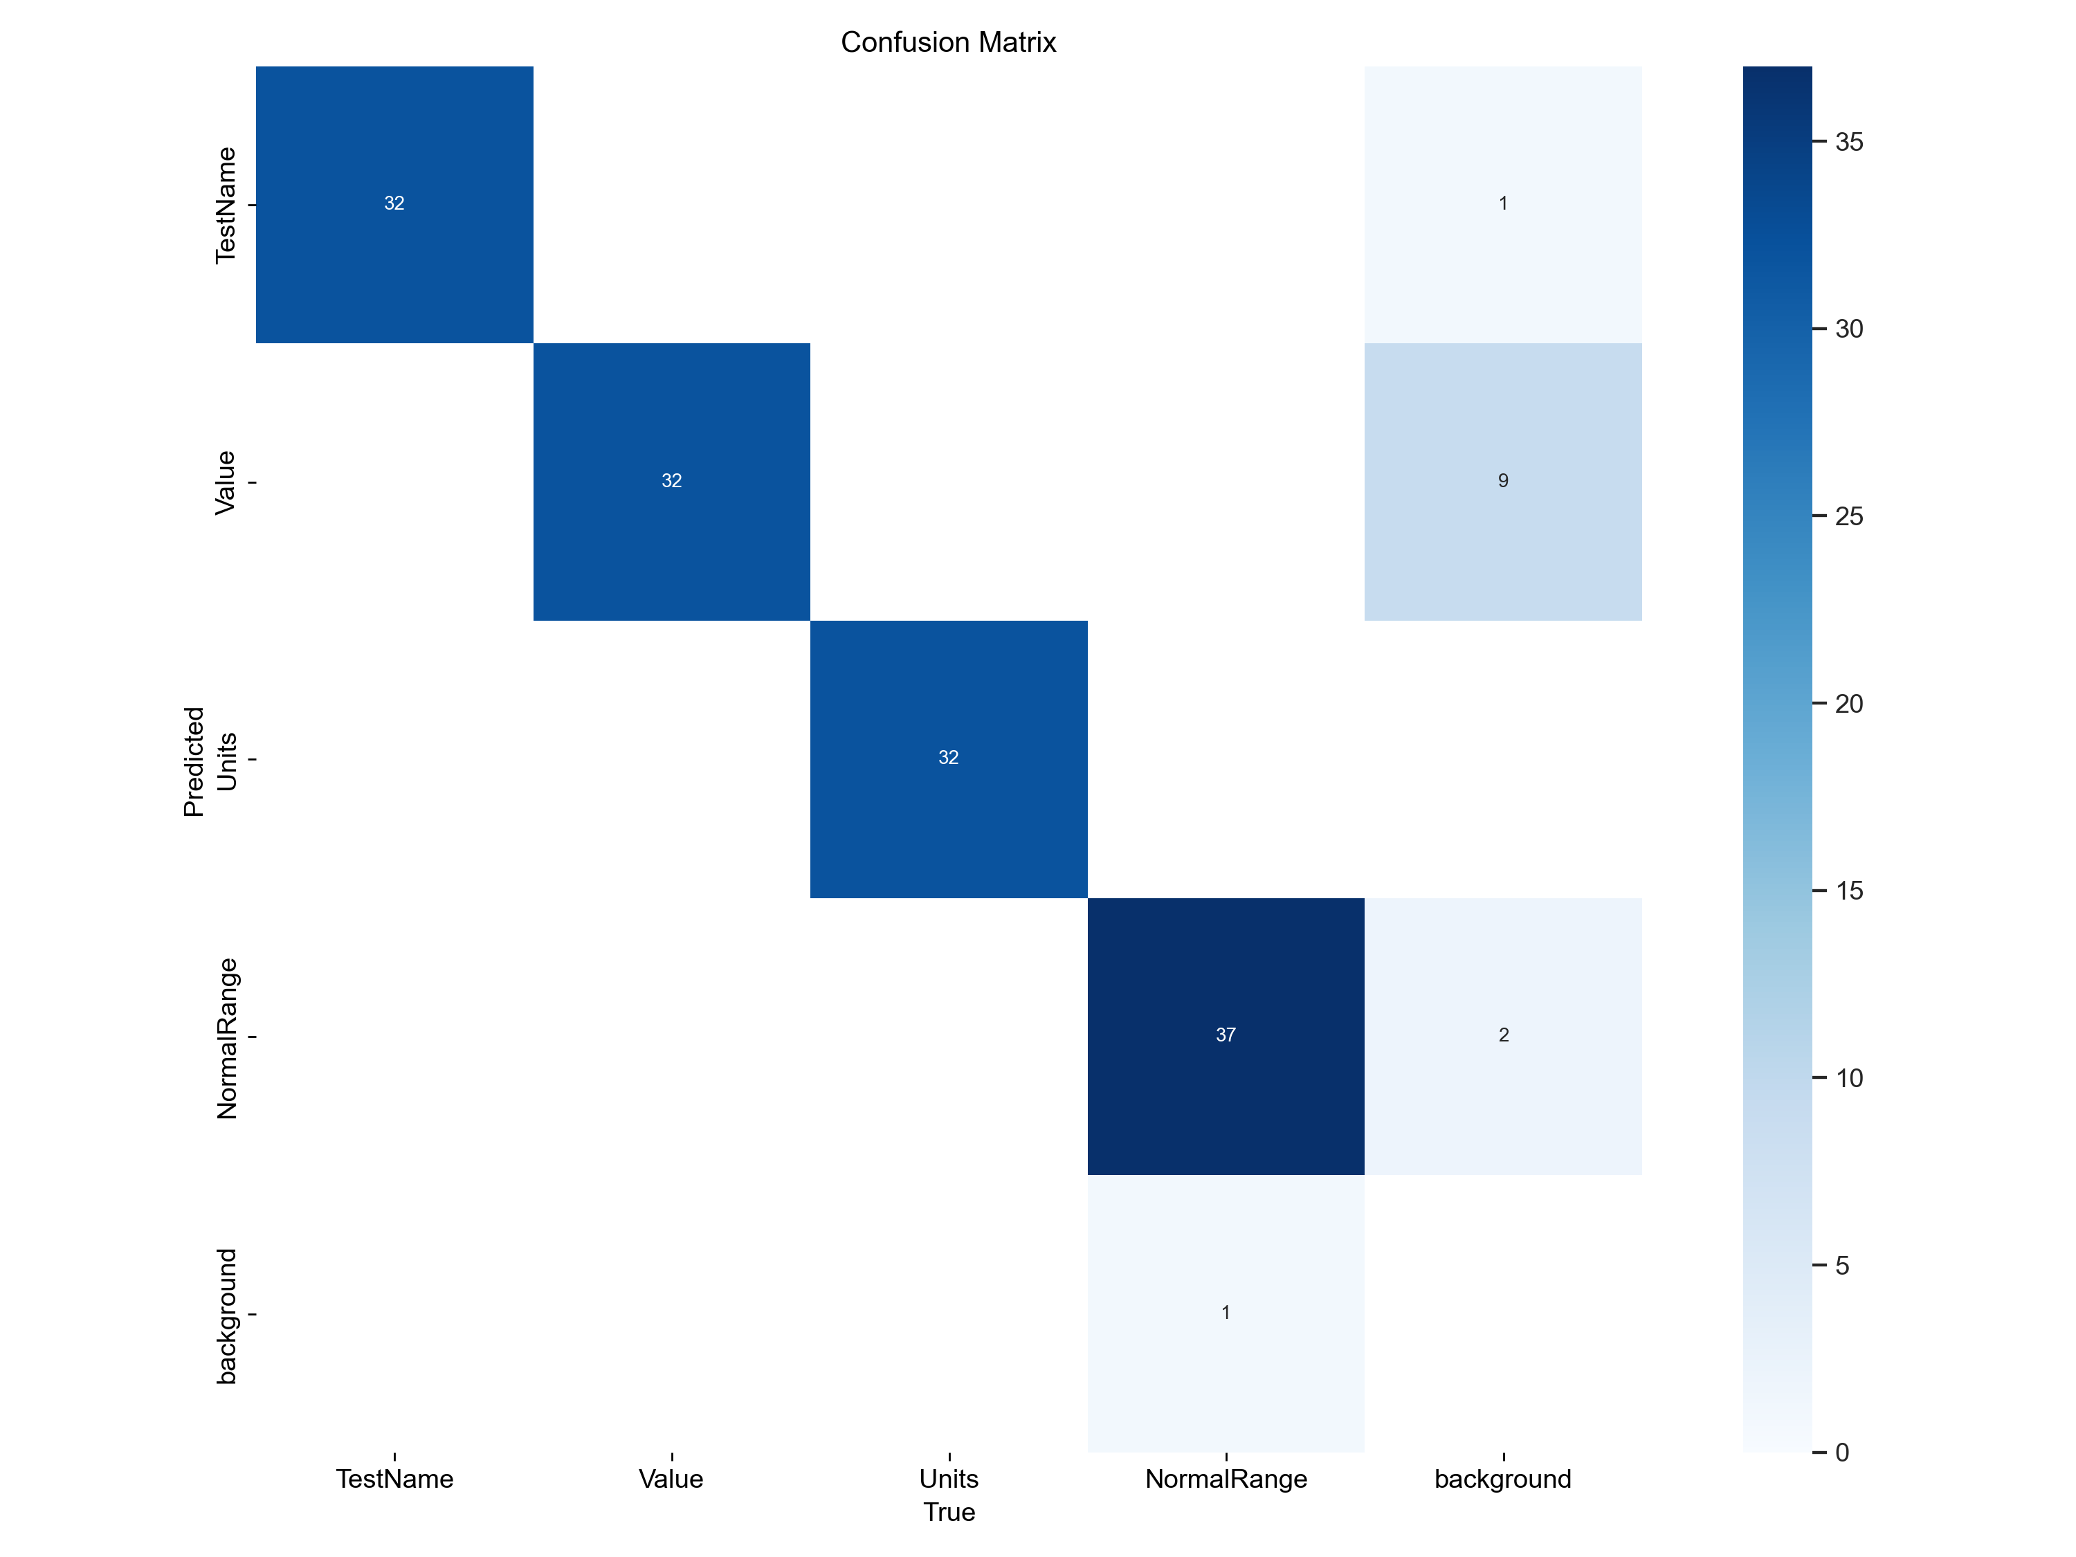
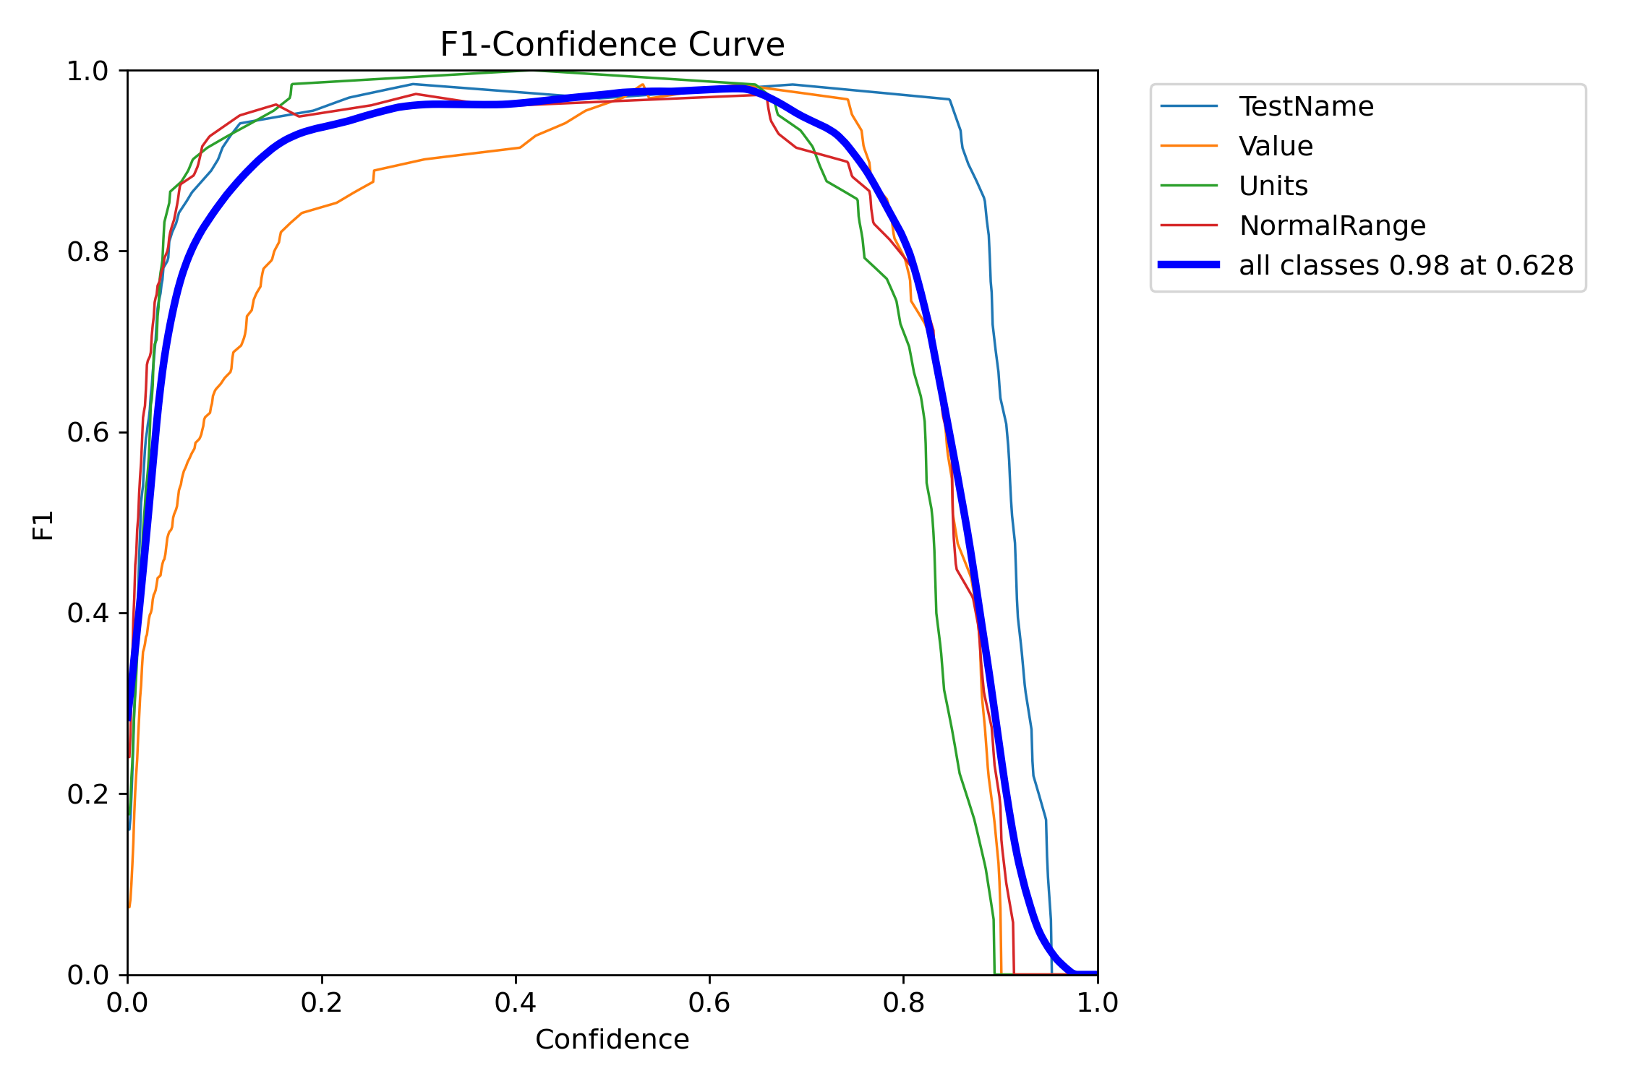
PHASE 3: OUTPUT OF THE TRAINED MODEL
Here are the results I got when I run the YOLO MODEL
confusion matrix F1 Confidence Curve

Slide 7
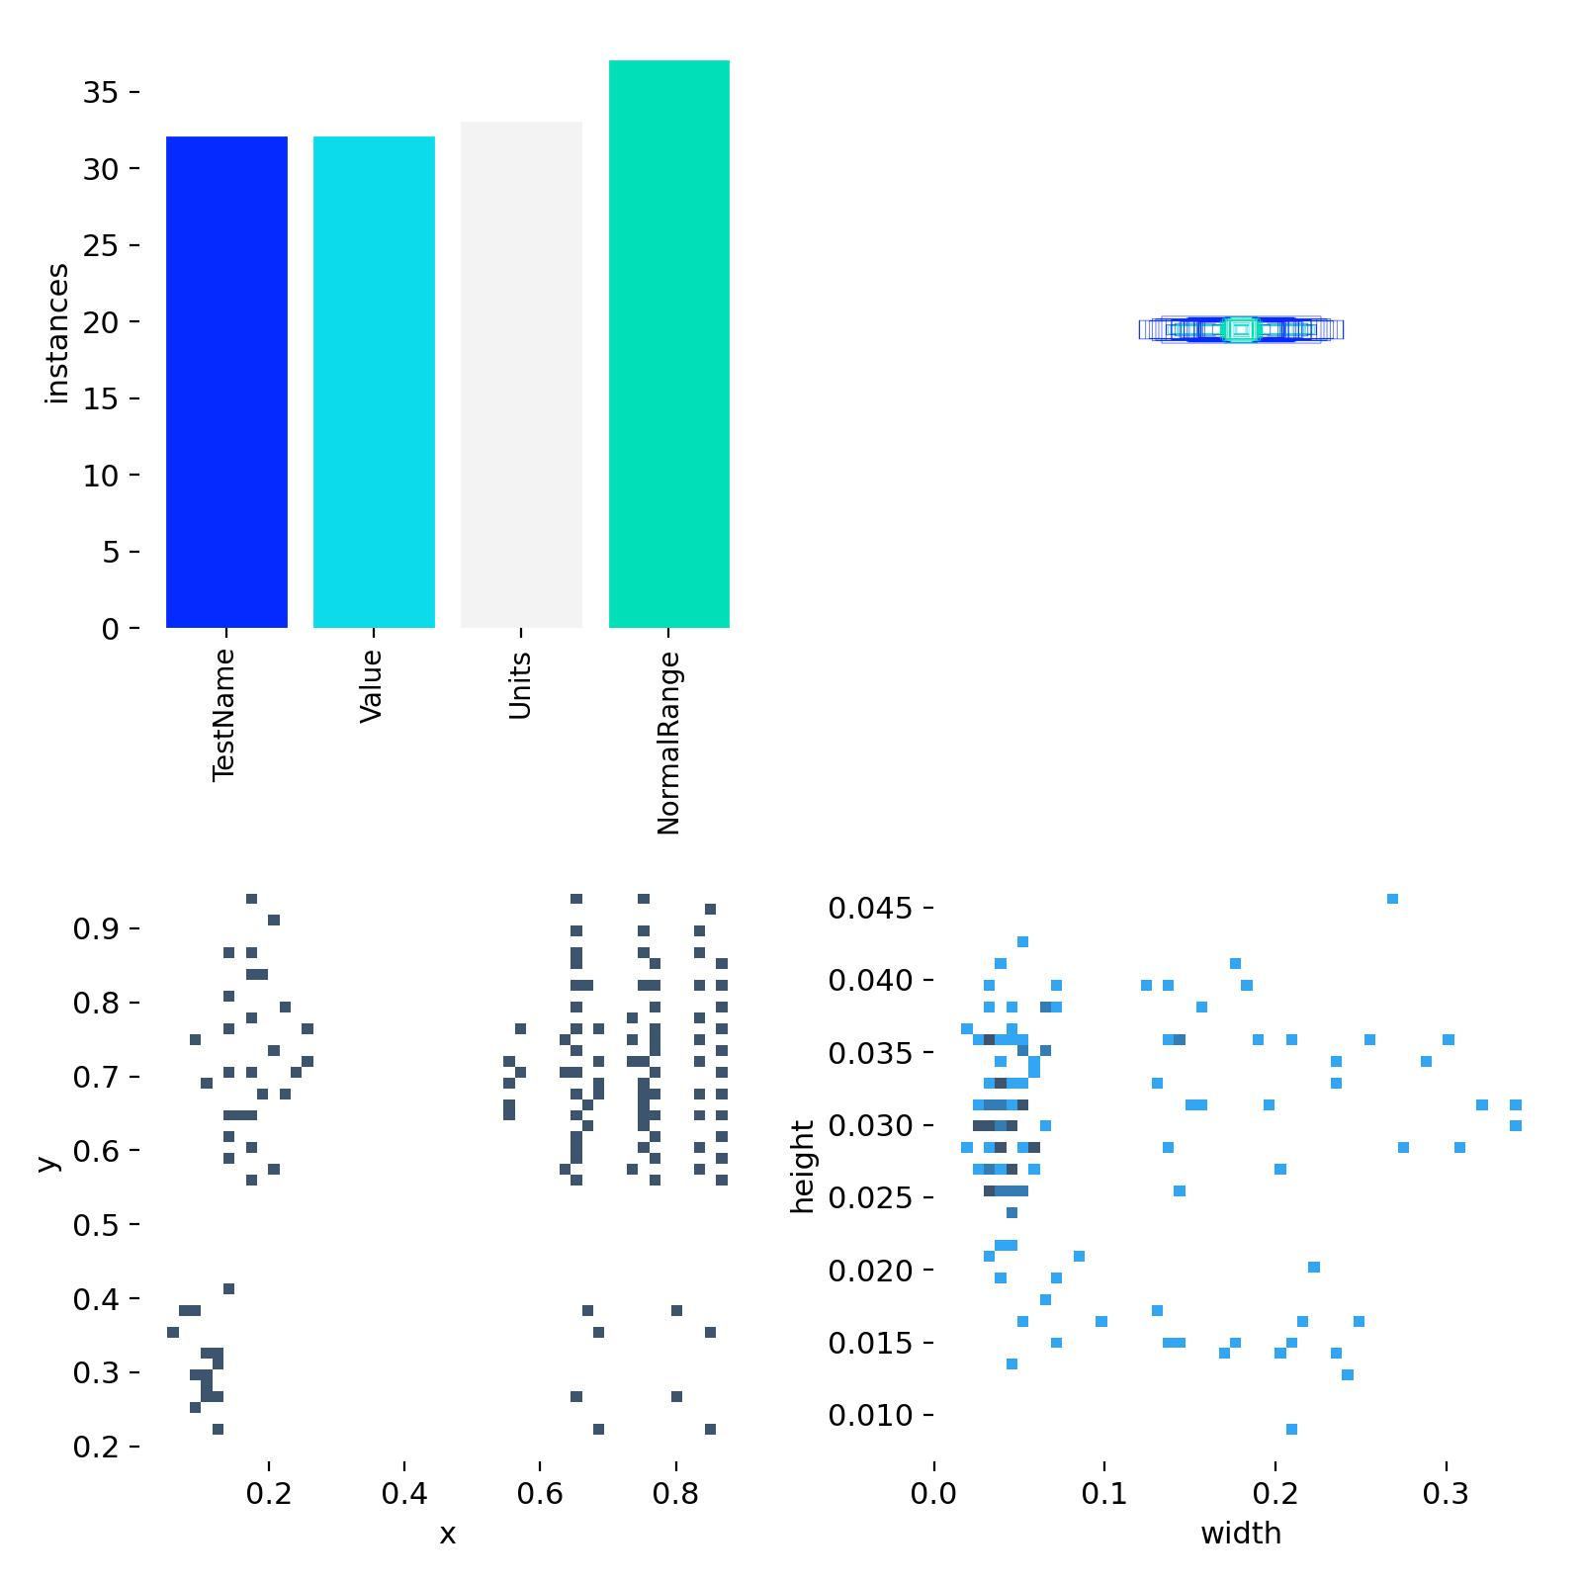
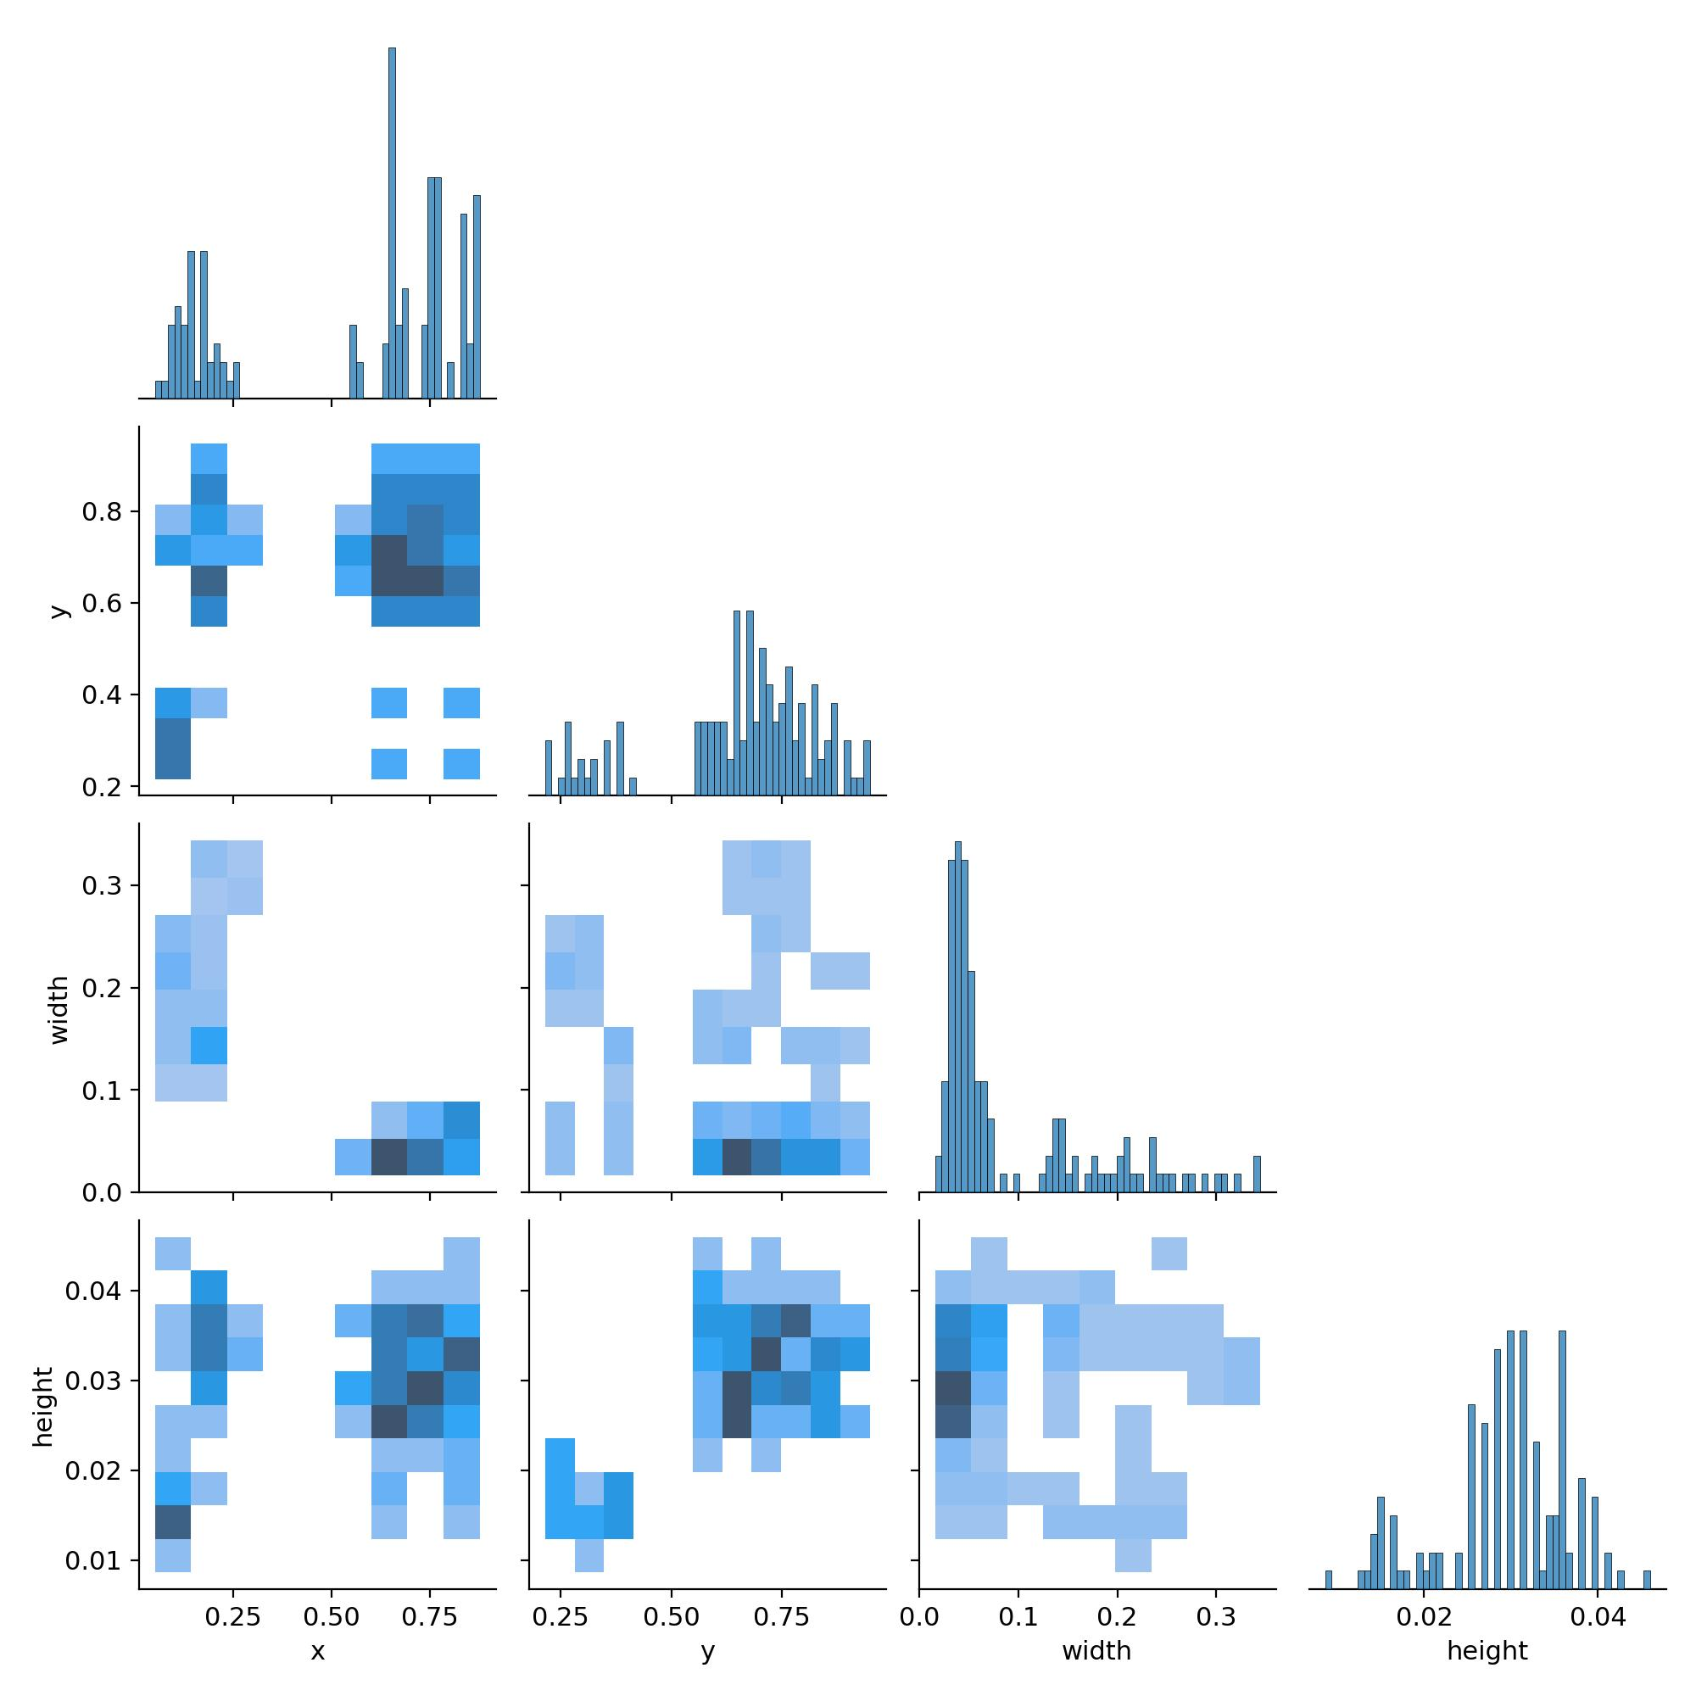
PHASE 3: OUTPUT OF THE TRAINED MODEL
Here are the results I got when I run the YOLO MODEL
Labels Label Corelogram

Slide 8
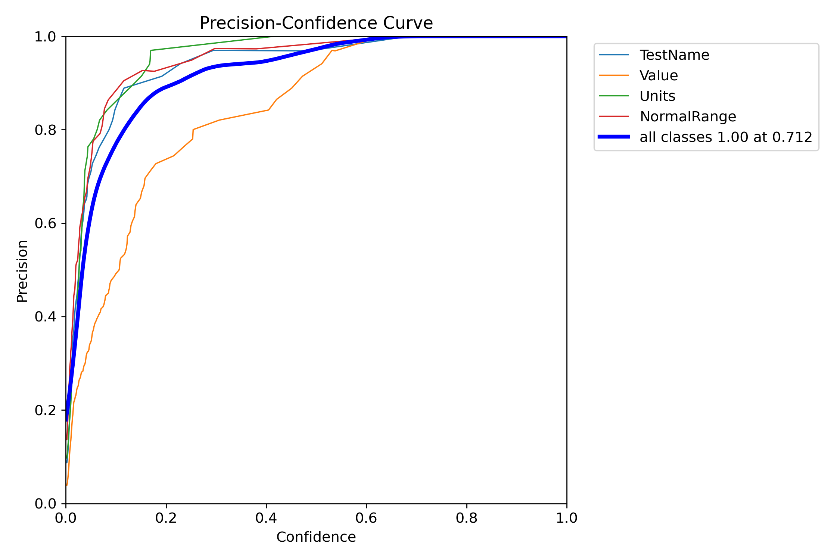
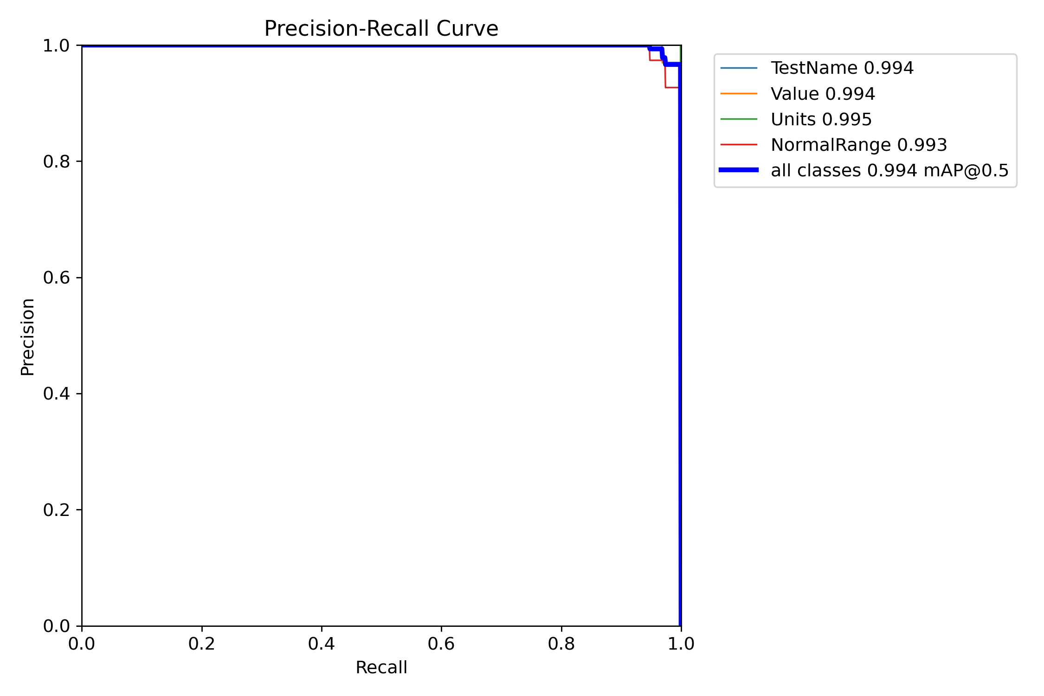
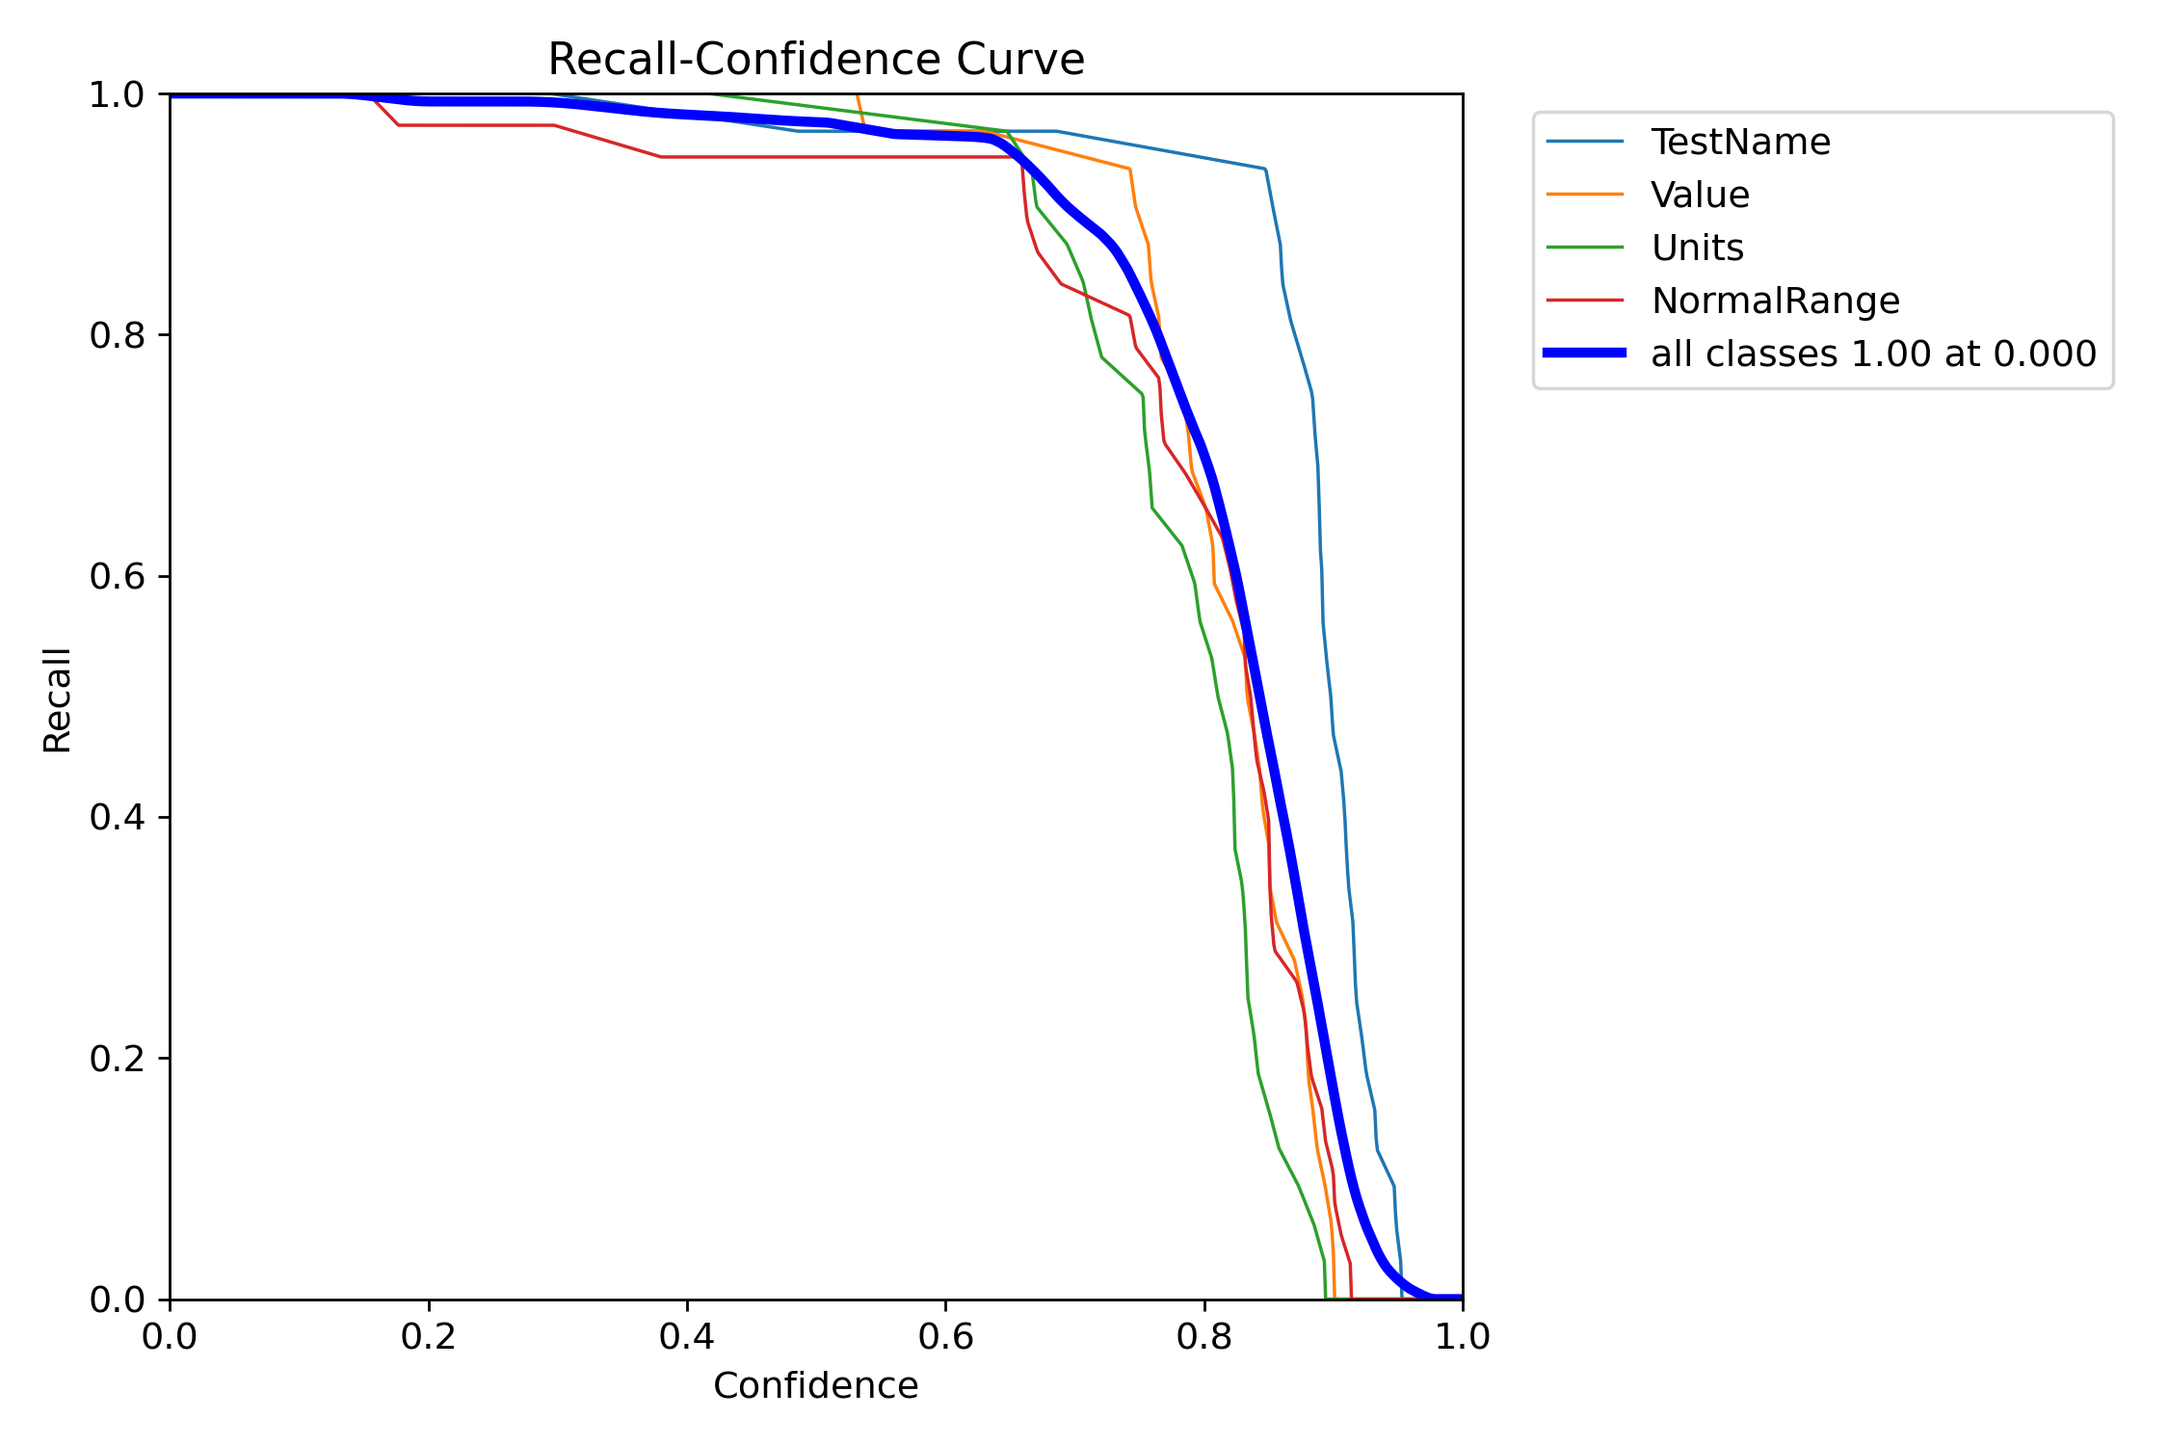
PHASE 3: OUTPUT OF THE TRAINED MODEL
Here are the results I got when I run the YOLO MODEL
P-Curve R-curve

Slide 9
PHASE 3: OUTPUT OF THE TRAINED MODEL
Here are the results I got when I run the YOLO MODEL
P-Curve PR-curve

Slide 10
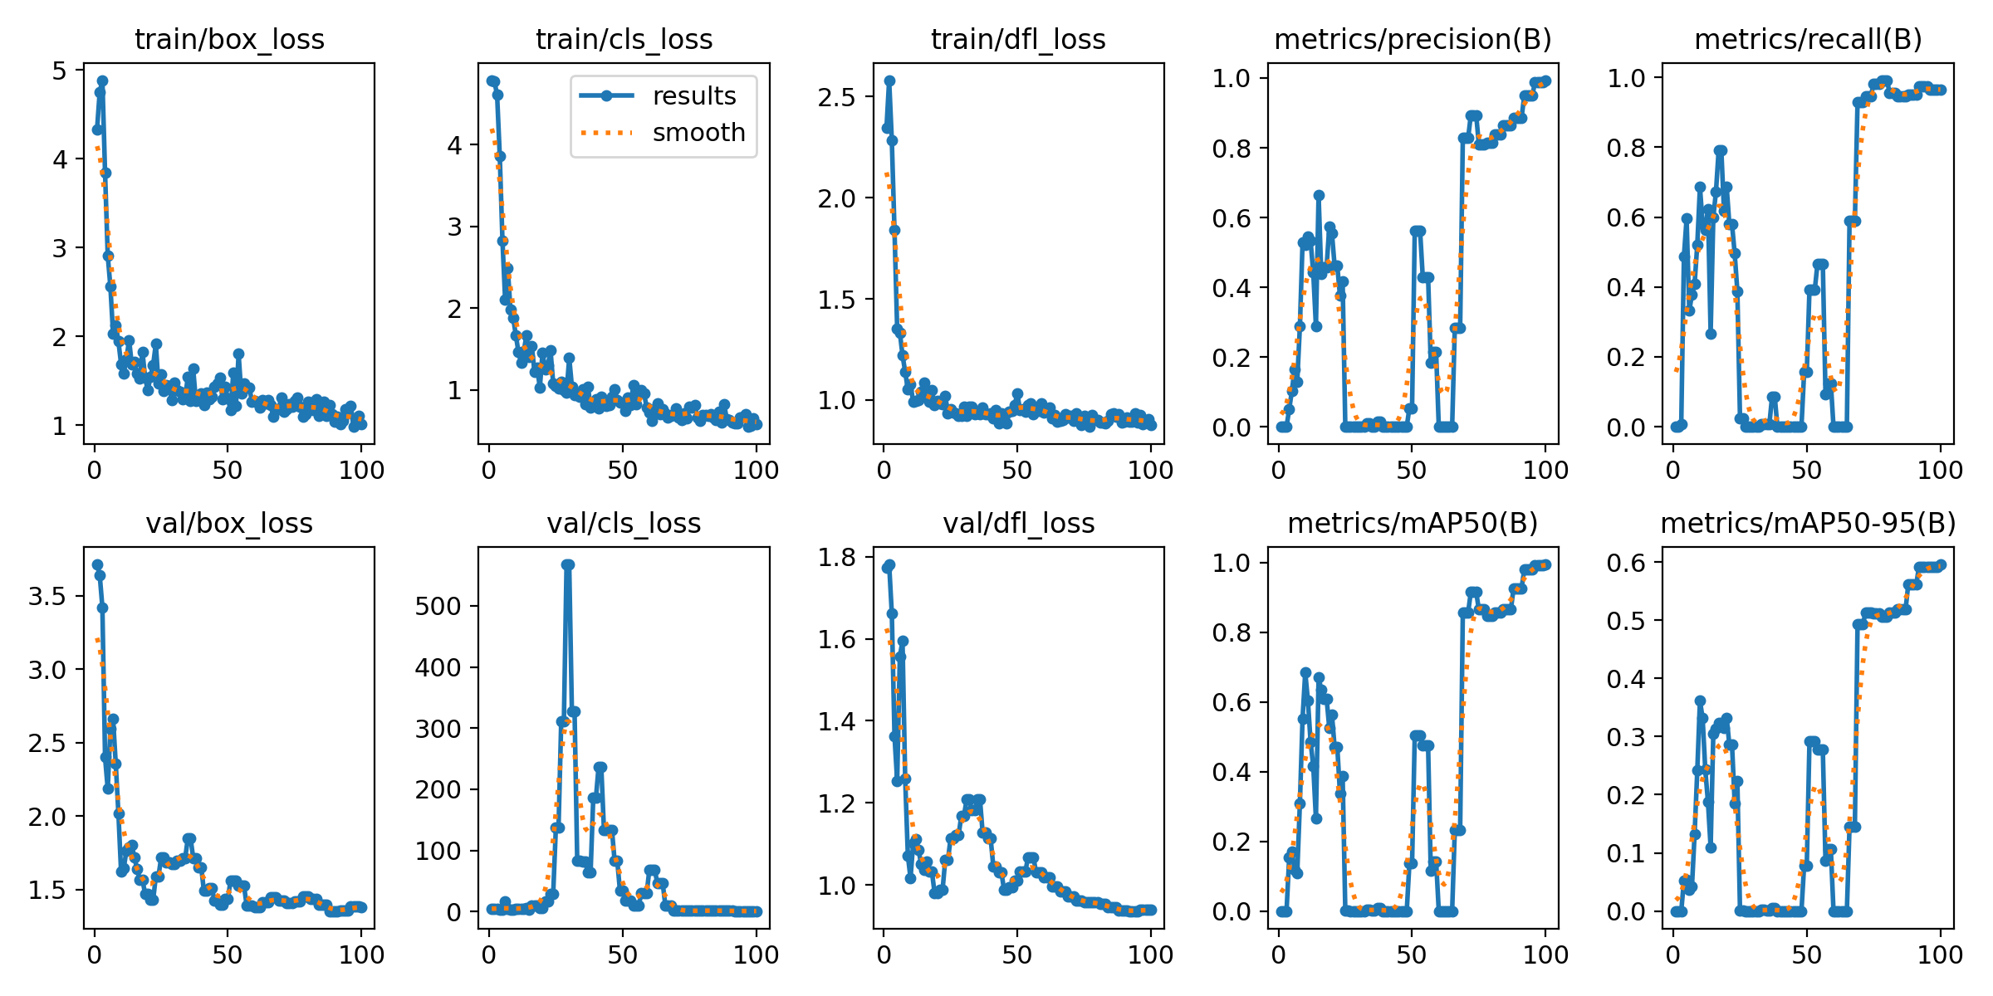
PHASE 3: OUTPUT OF THE TRAINED MODEL
Here are the results I got when I run the YOLO MODEL
Bounding Box Loss, Classification loss and other metrics

Slide 11
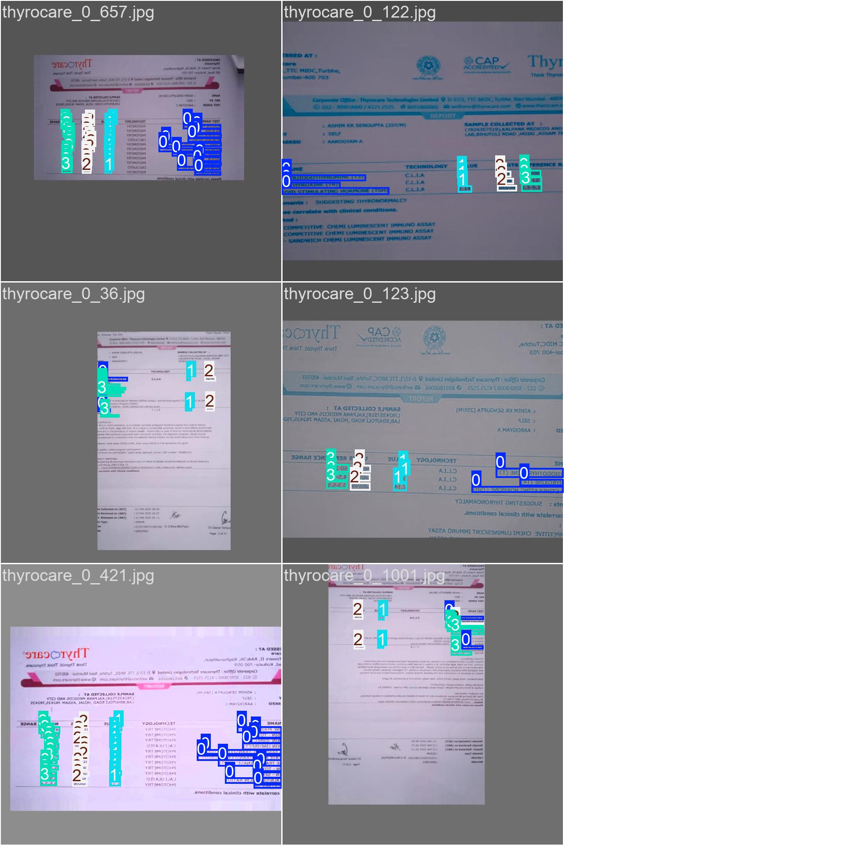
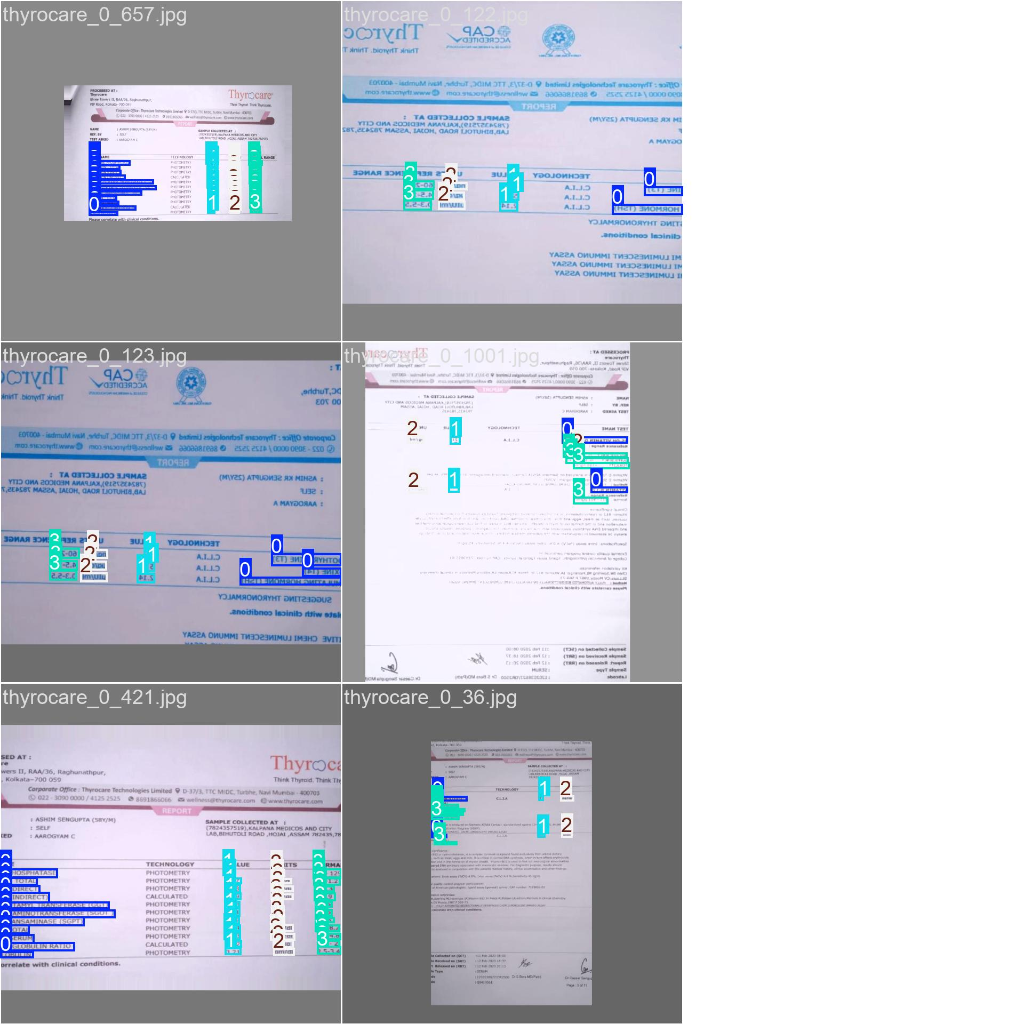
PHASE 3: OCR RECOGNITION OF THE TRAINED MODEL
Here are the results I got when I run the YOLO MODEL (OCR RECOGNITION)
Bounding Box Loss, Classification loss and other metrics

Slide 12
PHASE 4: TEXT DETECTION USING TESSERACT AND DEPLOYMENT USING STREAMLIT
Named the file as deploy.py and below are the steps explaining it one by one
Load the YOLO Model: The trained YOLO model (best.pt) is loaded to detect text regions in the image.
User Uploads an Image: The Streamlit UI allows users to upload images (jpg, jpeg, png).
Text Detection & Extraction: The YOLO model identifies text regions. Each detected region is cropped, converted to grayscale, and processed with Tesseract OCR to extract readable text.
Displaying Results: The original image is displayed first.
Then, the processed image is shown with bounding boxes around detected text.
Finally, the extracted text is displayed in a readable format.

Slide 13
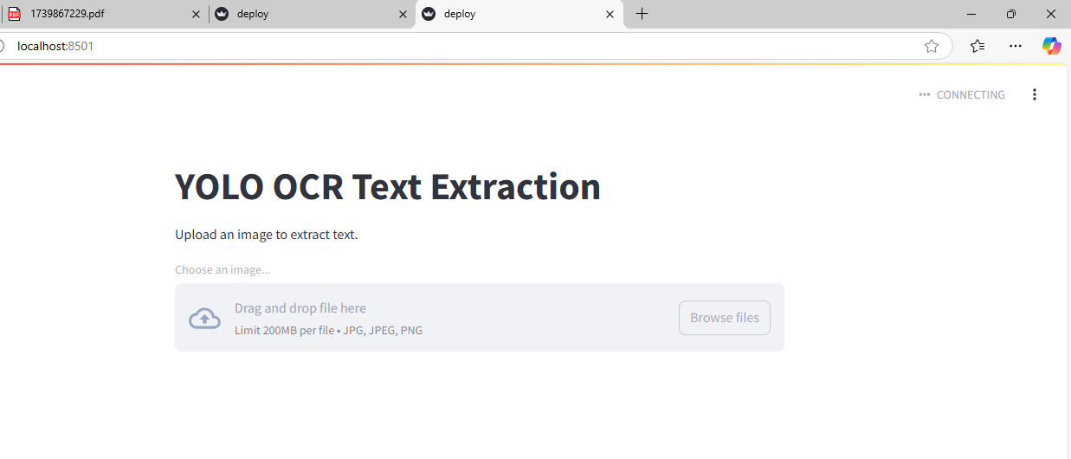
PHASE 5: DEPLOYMENT
Here is the screenshot of the streamlit interface page.

Slide 14
PHASE 6: TESTING
Here is the video of testing of the streamlit interface and how it gives the output.
I

Slide 15
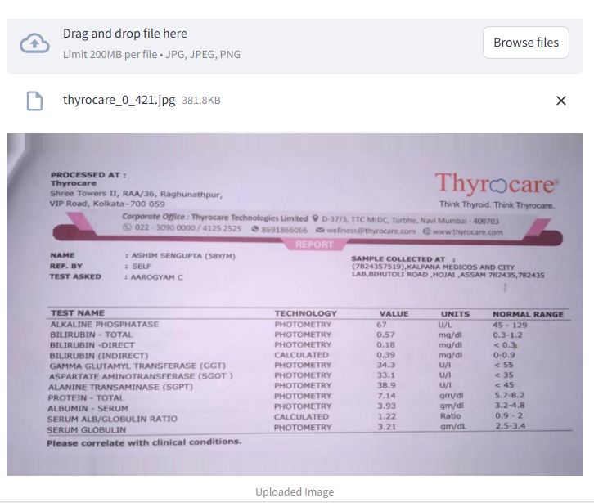
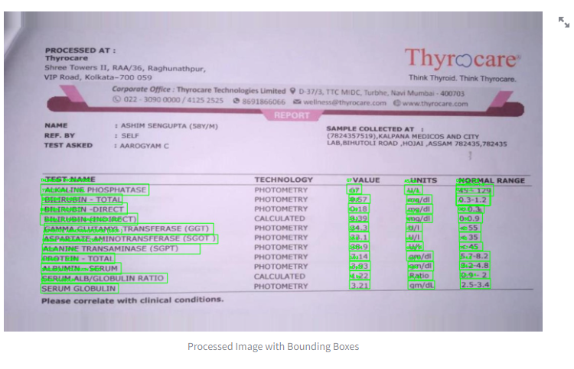
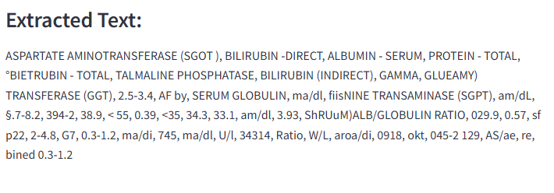
PHASE 7: SCREENSHOT OF THE OUTPUTS
Here are the screenshots of the outputs.
I

Slide 16
MODEL EVALUATION AND METRICS
Performance Analysis:
Bounding Box Loss & Classification Loss: Lower values indicate improved training stability.
2. Precision & Recall: Ensure the model is effectively detecting objects without excessive false positives or false negatives.
3. Mean Average Precision (mAP): Measures the overall detection accuracy across multiple IoU thresholds.
Validation vs. Training Metrics: Consistency between training and validation loss ensures the model generalizes well to unseen data.
RESULTS STORED IN: YOLOv3_Custom/yolov3_train/results.csv
LINK:
https://github.com/SUJANAKUMARI/PROJECT-10/blob/main/YOLOv3_Custom/yolov3_train/results.csv

Slide 17
S. SUJANA KUMARI
THANK YOU

